Slide 1

Industry Project Presentation on Swift Notes: AI-Powered Study Notes Generator
By
Dushyant K Vyas | 22162172006
Institute of Computer Technology, Ganpat University
Date: 25 – 3 – 2025

Slide 2
Table of Contents
Introduction
Objectives
Related Background
Expected Outcome
Tools & Technology
Methodology (Modules)
Design / Diagrams & TimeLine Charts with Milestones
Flowchart & Algorithms
Implementation Details
Conclusion
References

Slide 3
Introduction
Swift Notes is an AI powered study notes generator that automates the process of extracting text from PDF documents, summarizing key points, and organizing them into clear and concise study materials.
This project is designed to help students by providing quick, well-structured notes for better learning and revision.

Slide 4
Objectives
To extract structured text from PDF documents.
To generate concise summaries using advanced AI model(s).
To present summarized study notes in a user-friendly web interface.
To provide export options (PDF, text) for offline use.
To optimize for fast summarization.

Slide 5
Related Background
Traditional note-taking requires hours of reading and summarizing, leaving students overwhelmed and short on time.
Swift Notes aims to address this challenge by using AI to automate the process. With a simple PDF upload, the system will quickly generate well-organized study notes, allowing students to focus on understanding rather than manual summarization.
This tool is especially useful for:
Exam Preparation: Quickly condense lengthy chapters into concise study notes.
Research Summaries: Summarize academic papers for faster comprehension.
Revision: Create structured notes for quick reference during exam preparation.

Slide 6
Expected Outcome
An operational web app that allows PDF uploads and generates AI-powered summaries.
Export functionality to save notes as PDF or plain text.
Reading mode [for people who don’t prefer downloading].
Fast and accurate processing of large academic documents.

Slide 7
Tools and Technologies
Programming Language: Python
Framework: Django
AI Model: Google Gemini 1.5 Pro, accessed via the official google.generativeai Python SDK for advanced summarization
PDF Processing: PyMuPDF (fitz)
Database: MongoDB, integrated via the ‘djongo’ library
Frontend: HTML, CSS, JavaScript, and CSS framework ‘PICO CSS’
Export: ReportLab – for enabling downloadable study note summaries in PDF format
Deployment: Render / Heroku – for making the app publicly accessible online

Slide 8
Methodology (Modules)
PDF Text Extraction: Extracts and sanitizes raw text from uploaded PDF files using PyMuPDF.
Summarization Engine: Uses Google Gemini 1.5 Pro to generate accurate and concise summaries, with bullet points.
Web Interface: Allows users to upload PDFs, view results, and download summaries.
Optimization: Applies chunking and API limit control for large document processing.

Slide 9
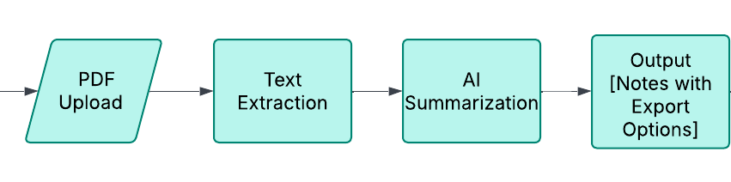
Design/Diagrams & Timeline
System Architecture Diagram
Timeline
Week 1 – 2: PDF Processing and Extraction & Implementing AI Summarization
Week 3 – 4: Testing Robustness, Optimizing and Deployment
Web – App : Progressive

Slide 10
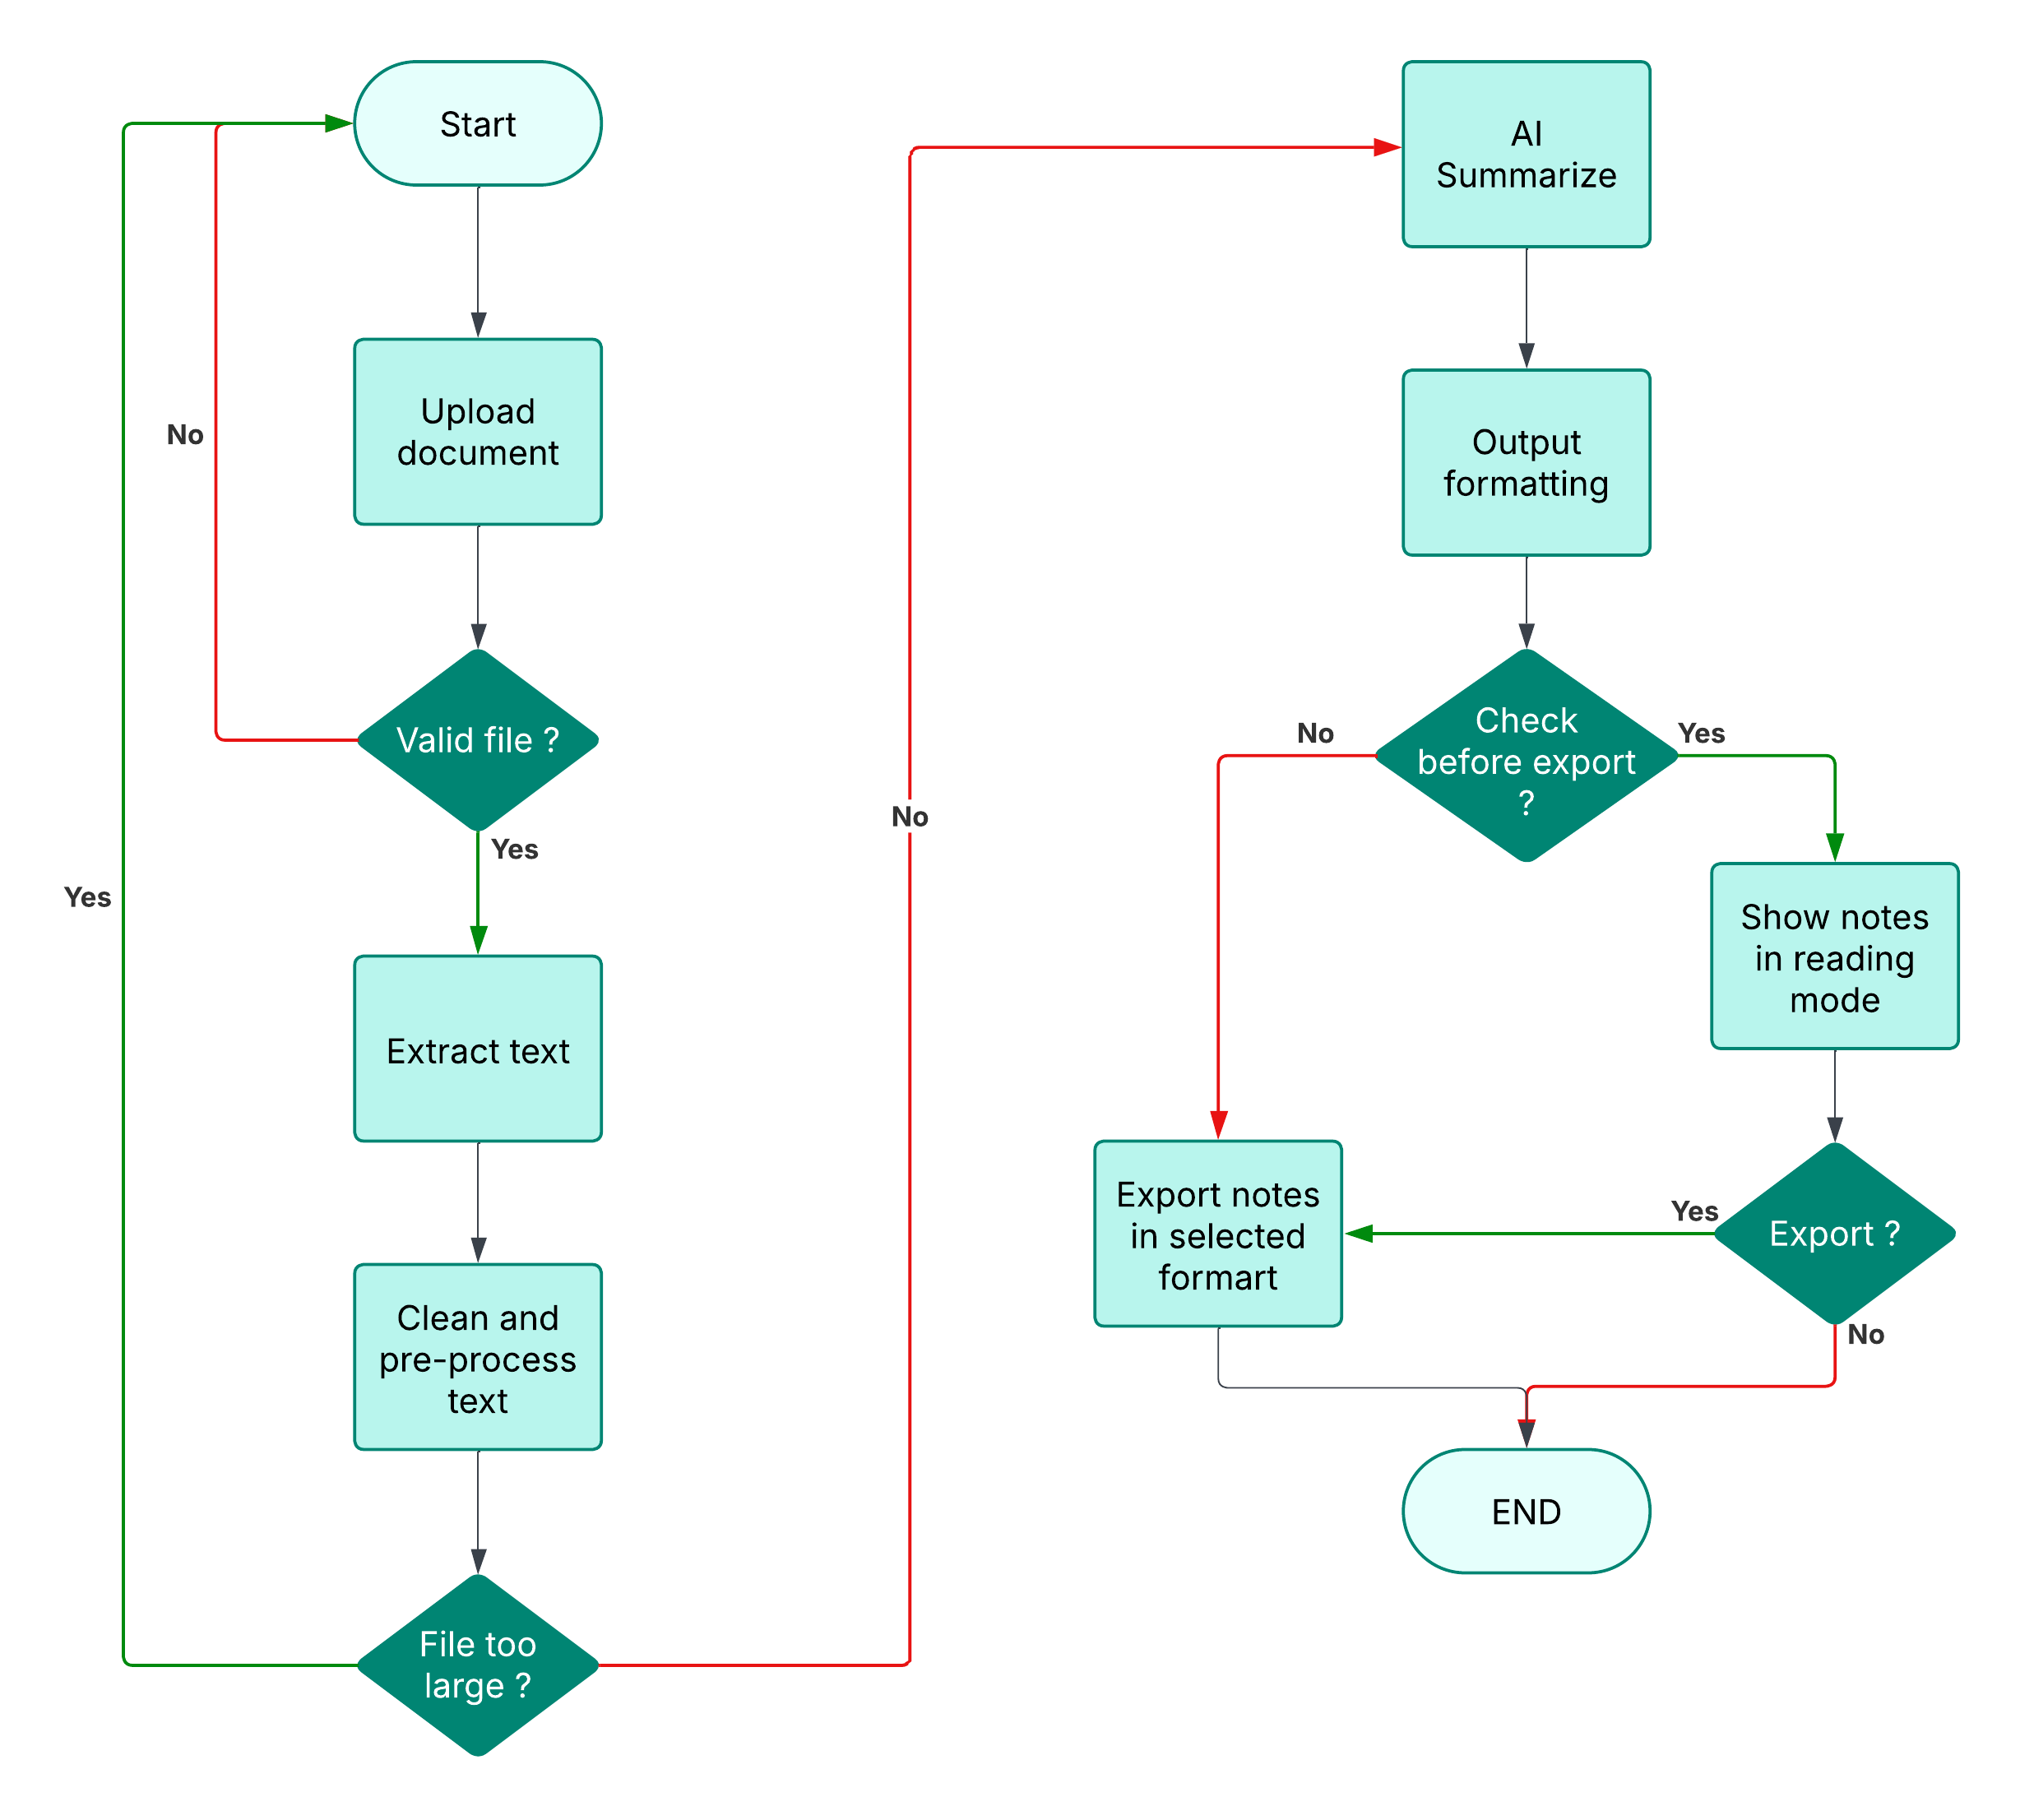
Flowchart & Algorithms
Key Algorithms
Extract text using PyMuPDF.
Summarize using Gemini 1.5 Pro for advanced text comprehension and coherence.
Flowchart [Complete process]

Slide 11
Implementation Details
Text Extraction: Using PyMuPDF to retrieve clean, structured text.
Summarization: Leveraging Google’s Generative AI for precise output.
User Interface: Built with Django to allow file uploads and output display.
Export Feature: Using ReportLab to convert summaries into downloadable PDFs.

Slide 12

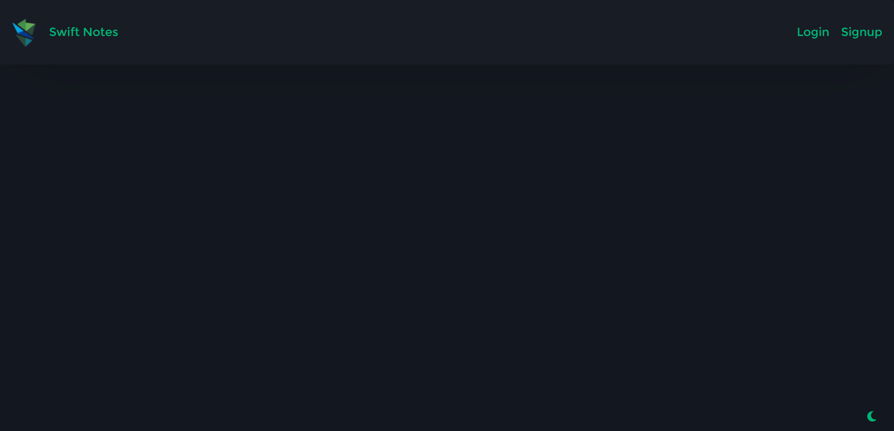
Screenshots

Slide 13
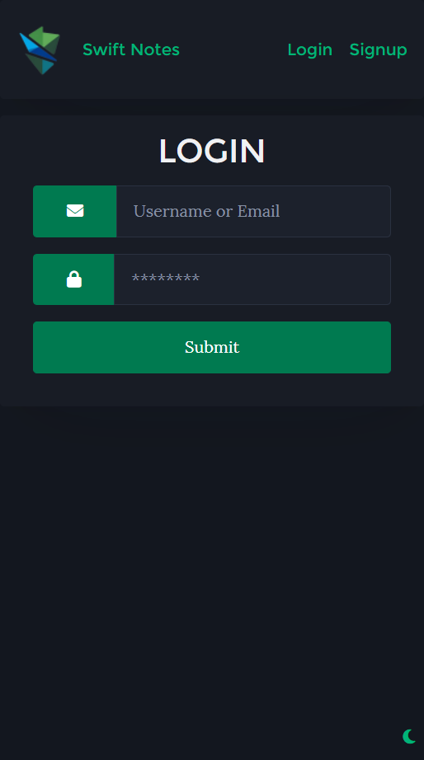
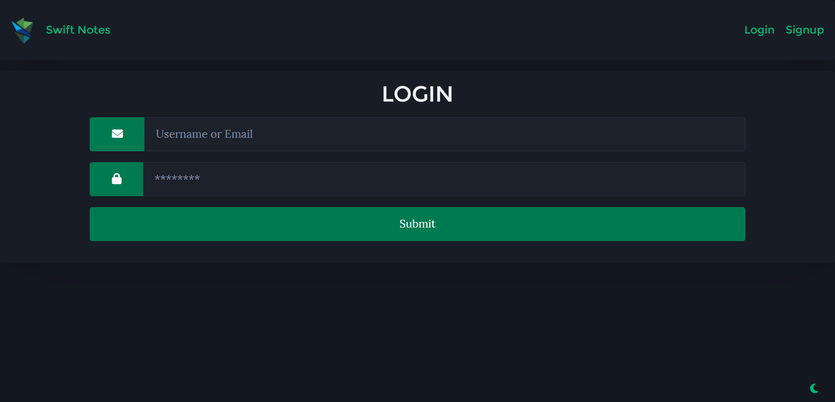
Screenshots

Slide 14
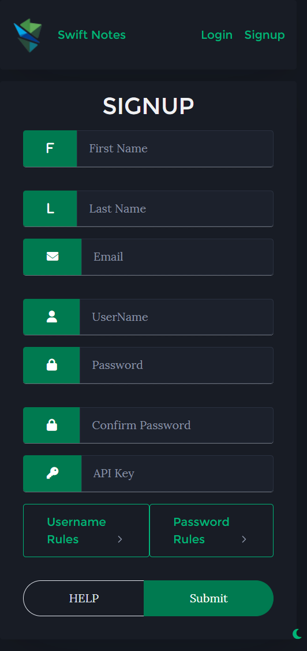
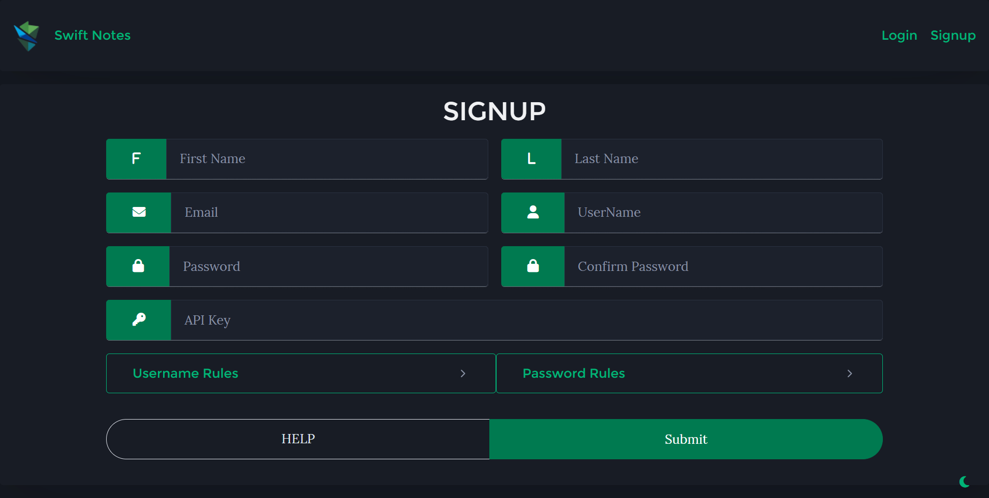
Screenshots

Slide 15
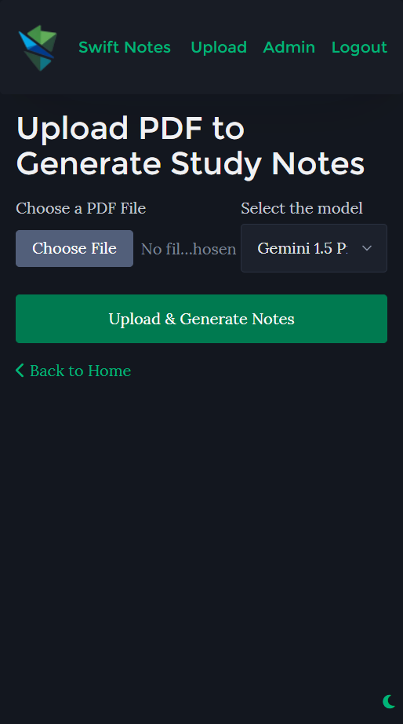
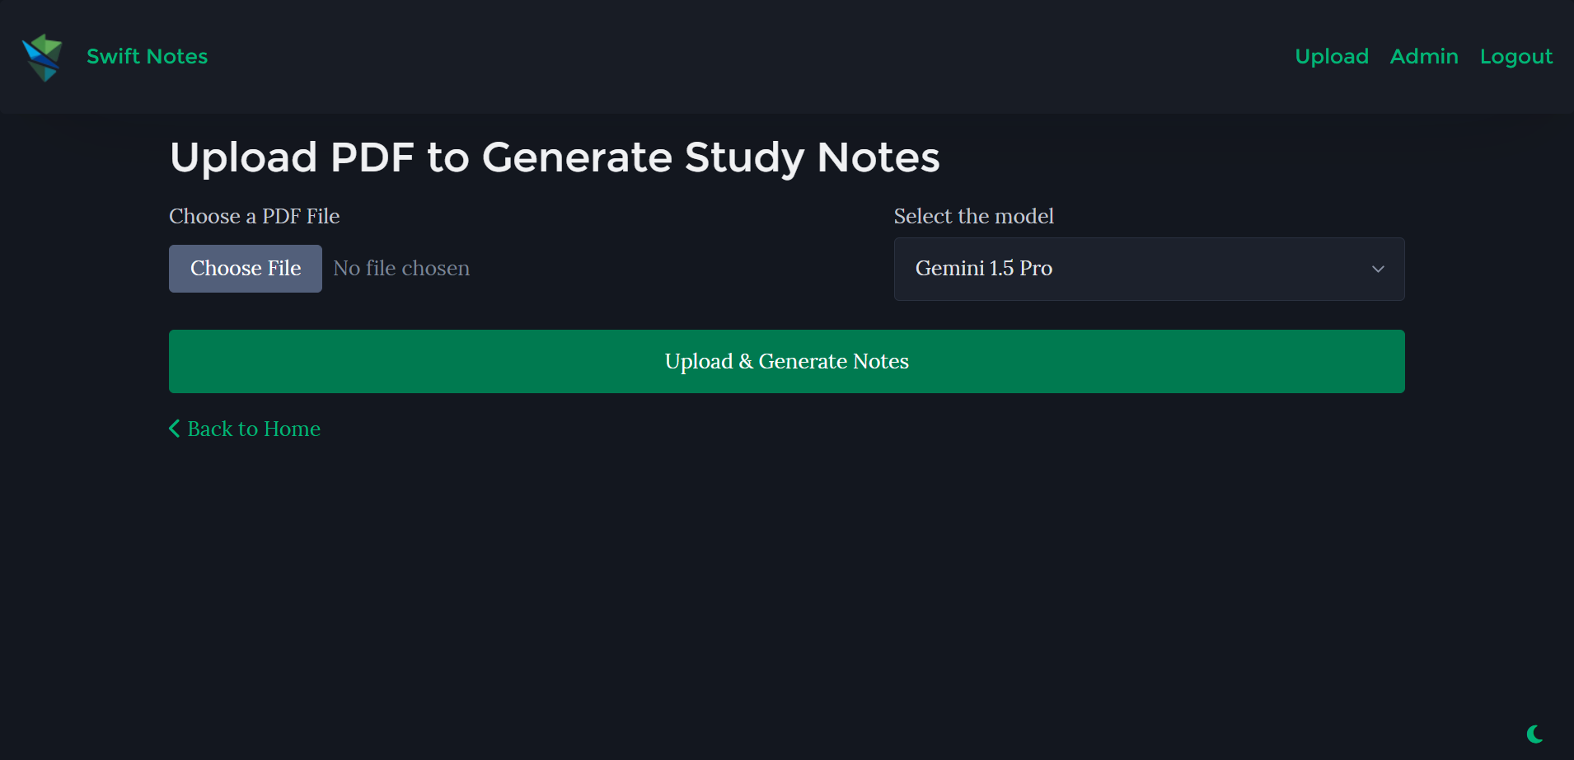
Screenshots

Slide 16
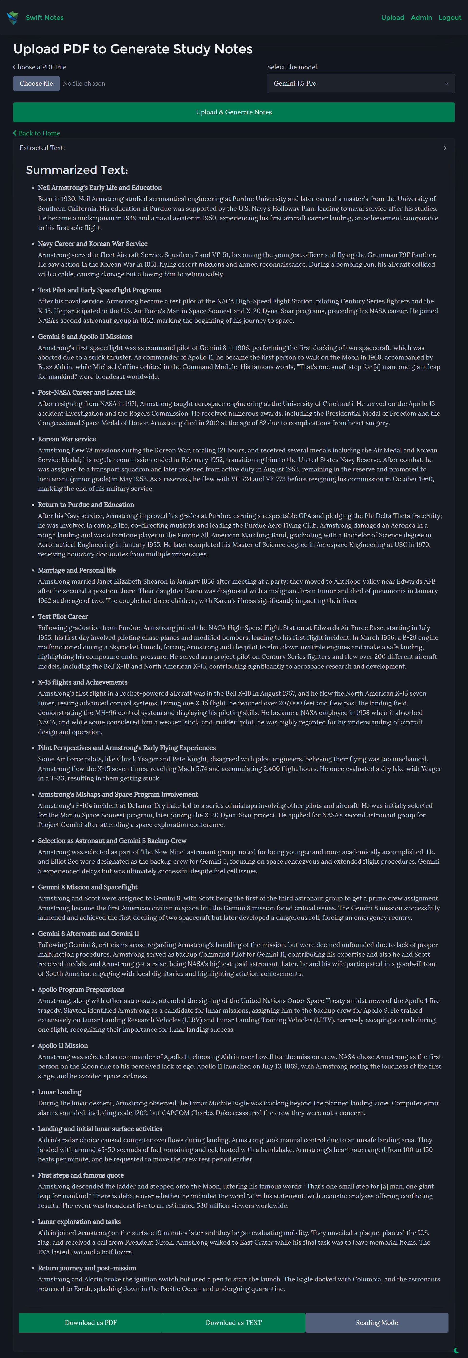
Screenshots

Slide 17
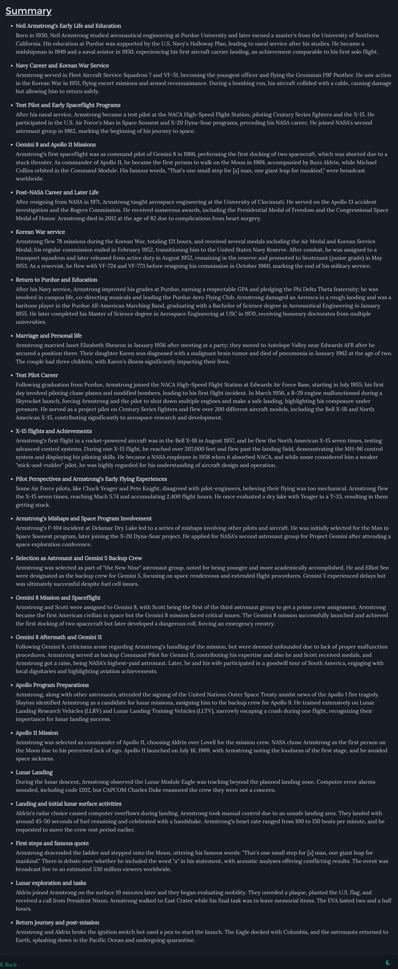
Screenshots

Slide 18
Conclusion
Swift Notes aims to automate the process of creating structured study materials from academic PDFs.
It enhances learning efficiency by providing quick summaries and allows for seamless document handling and export.
Future work includes adding support for hand-written notes.

Slide 19
References
Google Gemini API Documentation: Gemini AI Documentation
PyMuPDF (fitz) Documentation: PyMuPDF 1.25.4 documentation
Django Framework Documentation: Django documentation | Django documentation | Django
ChatGPT: ChatGPT

Slide 20
Thank You !!

